Slide 1
BIR Training
Bureau of Internal Revenue
Notes:
Main Title Page

Slide 2


BIR Training
Introduction
What is BIR?
What is PWD?
Bureau of Internal Revenue (BIR) is an attached agency of the Department of Finance exclusively for our customers in the Philippines
It is tasked to assess and collect all national internal revenue taxes, fees, and charges, and to enforce all forfeitures, penalties, and fines connected therewith
Long-term physical, mental, intellectual, or sensory impairments can interact with other factors to prevent some people from participating fully and effectively in society on an equal footing
What is SC?
Senior citizen or elderly refers to any resident citizen of the Philippines at least sixty (60) years old
PWD & SC can enjoy 20% discount and exemption from the Value Added Tax (VAT)
BIR = Bureau of Internal Revenue | PWD = Person With Disability | SC = Senior Citizen

Slide 3
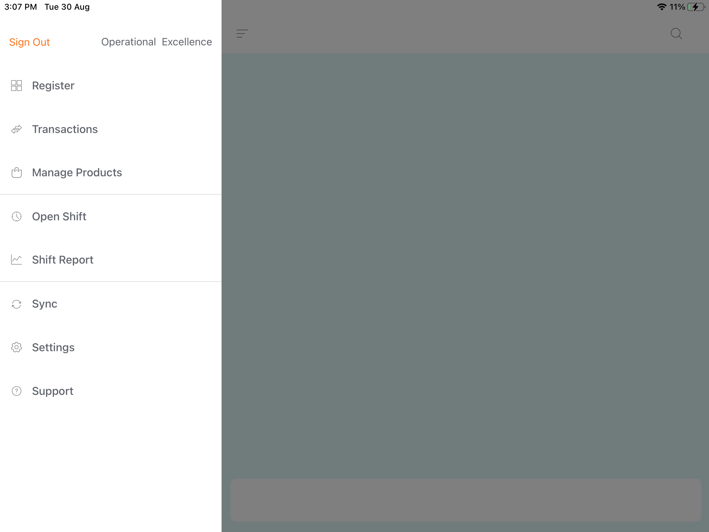
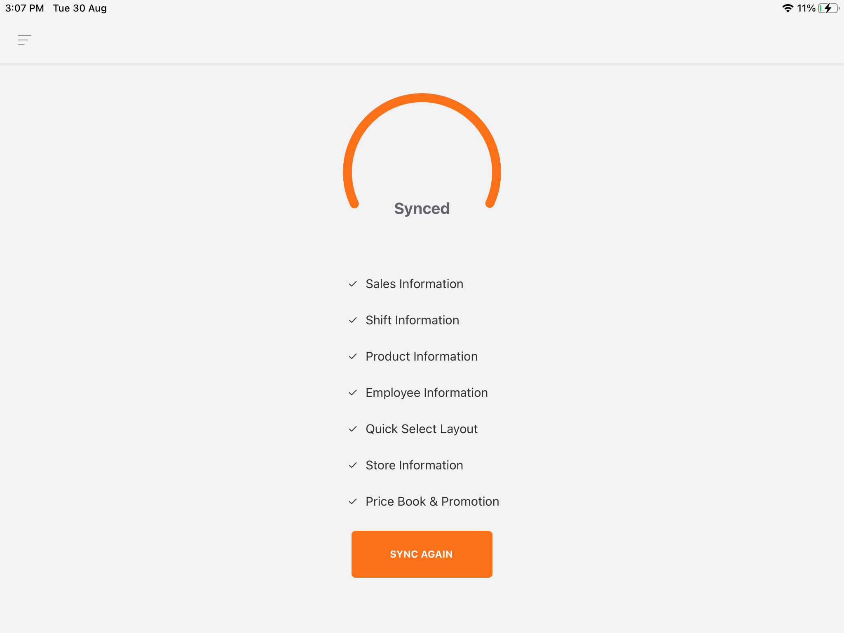
BIR Training
Things to Complete before Enabling BIR
2
Task 1: Sync your POS system with latest info
Click Sync
Automatically your POS will be updated
1
2
1
BIR = Bureau of Internal Revenue | POS = Point of Sales

Slide 4
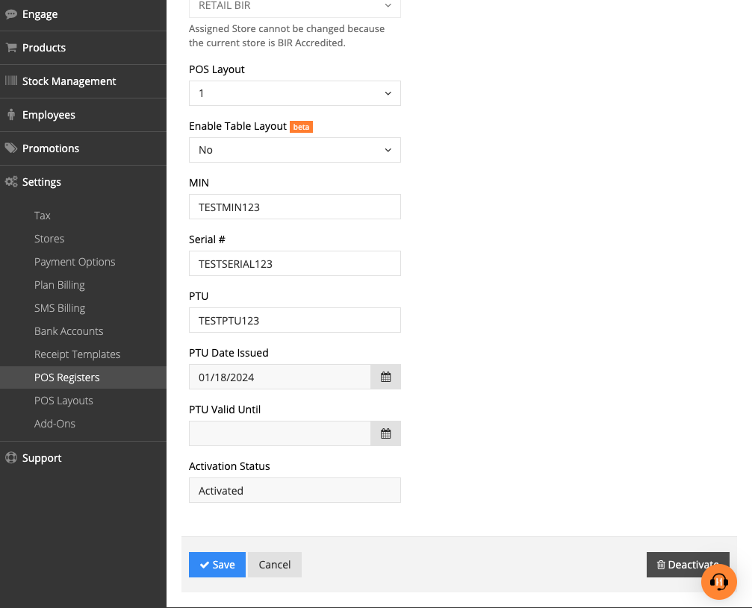
BIR Training
Things to Complete before Enabling BIR (cont.)
Task 2: Deactivate POS before activating BIR settings
Click BackOffice > Settings > POS Registers
Click “Deactivate”
Click “Save”
1
2
1
3
3
2
BIR = Bureau of Internal Revenue | POS = Point of Sales

Slide 5
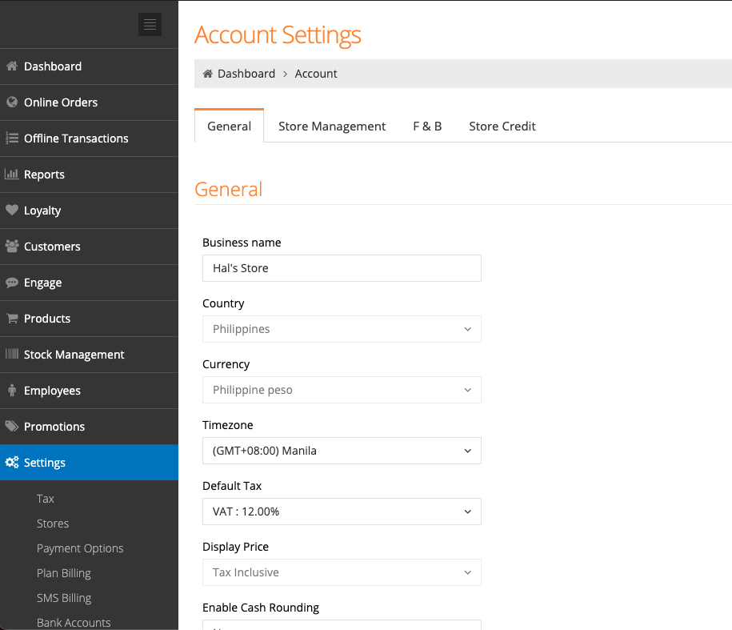
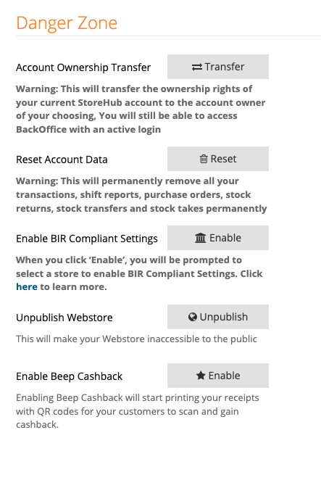
BIR Training
Enable BIR
2
Click BackOffice > Settings
In the General tab, scroll down and you may find Danger Zone
Click Enable for “Enabling BIR Compliant Settings”
1
2
1
3
3
BIR = Bureau of Internal Revenue

Slide 6
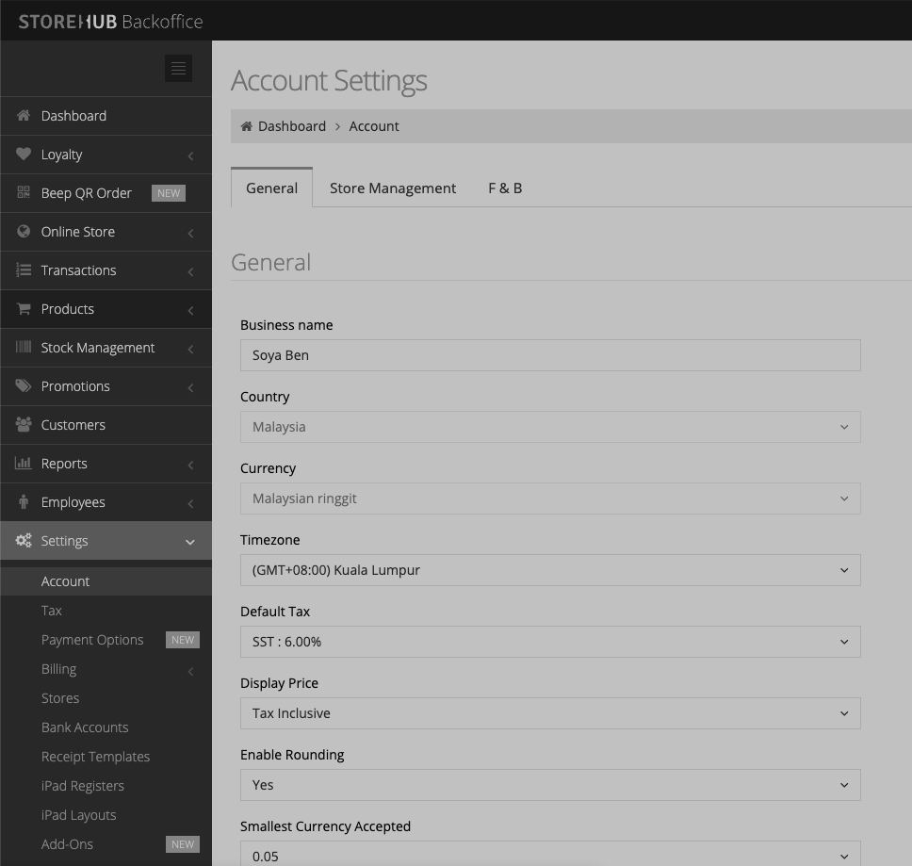
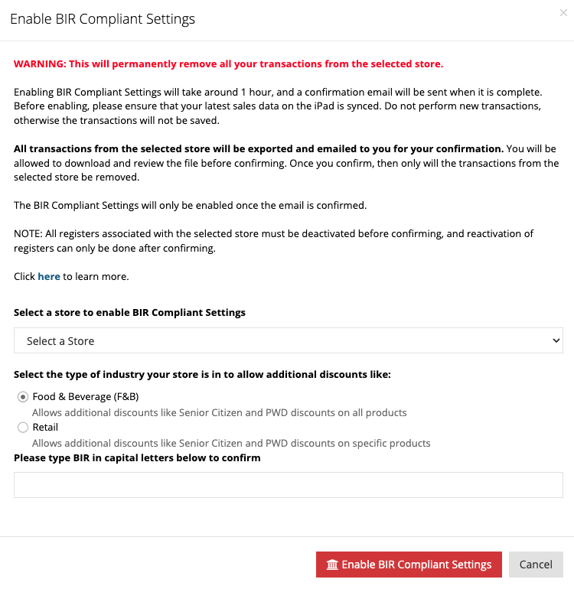
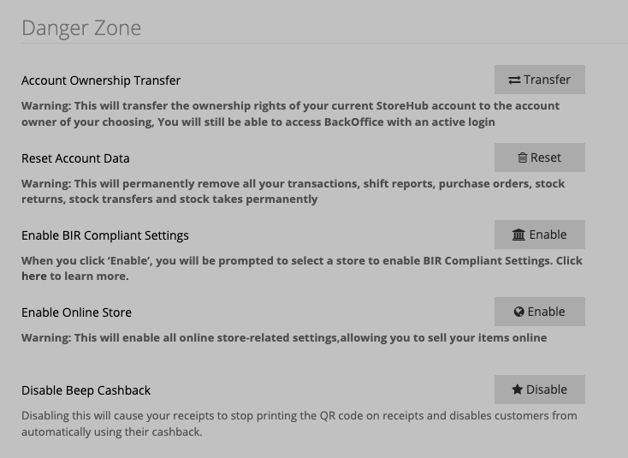
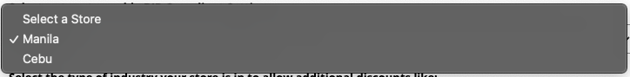
BIR Training
Enable BIR (cont.)
Select Stores that you want to enable BIR Settings
Select the type of Business
Type in “BIR” in capital letters to confrim
4
4
5
5
6
6
BIR = Bureau of Internal Revenue

Slide 7
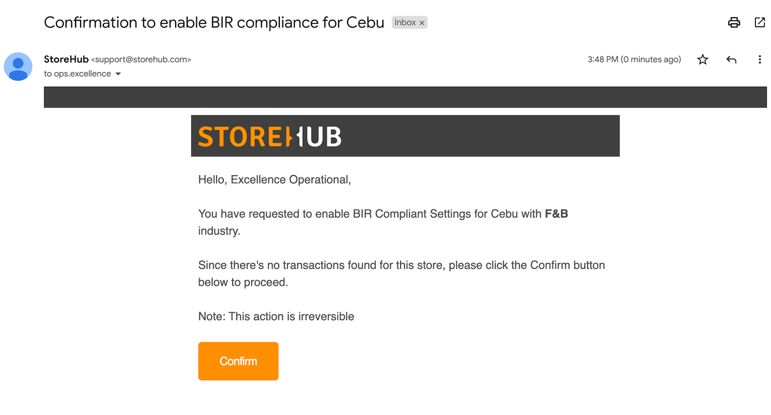
BIR Training
Enable BIR (cont.)
7
Login to your Email & find an email from StoreHub
Click Confirm to Confirm your BIR Settings
7
8
8
BIR = Bureau of Internal Revenue

Slide 8
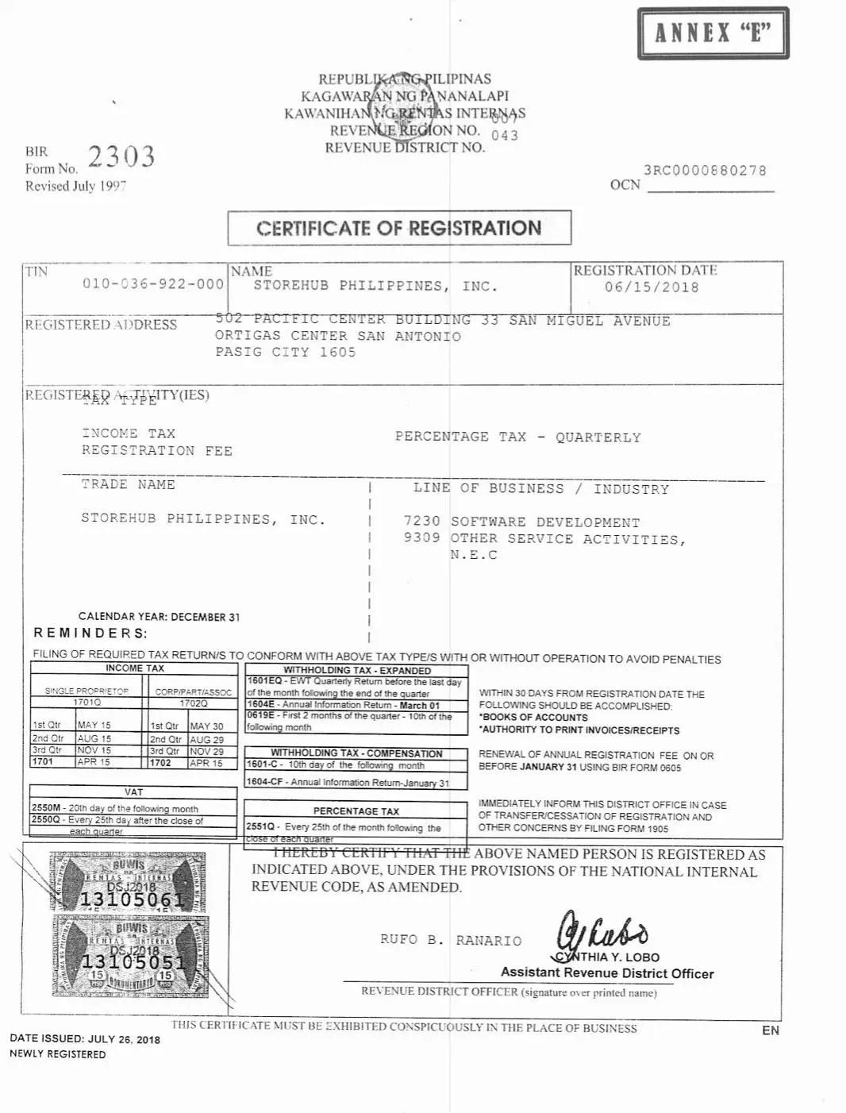
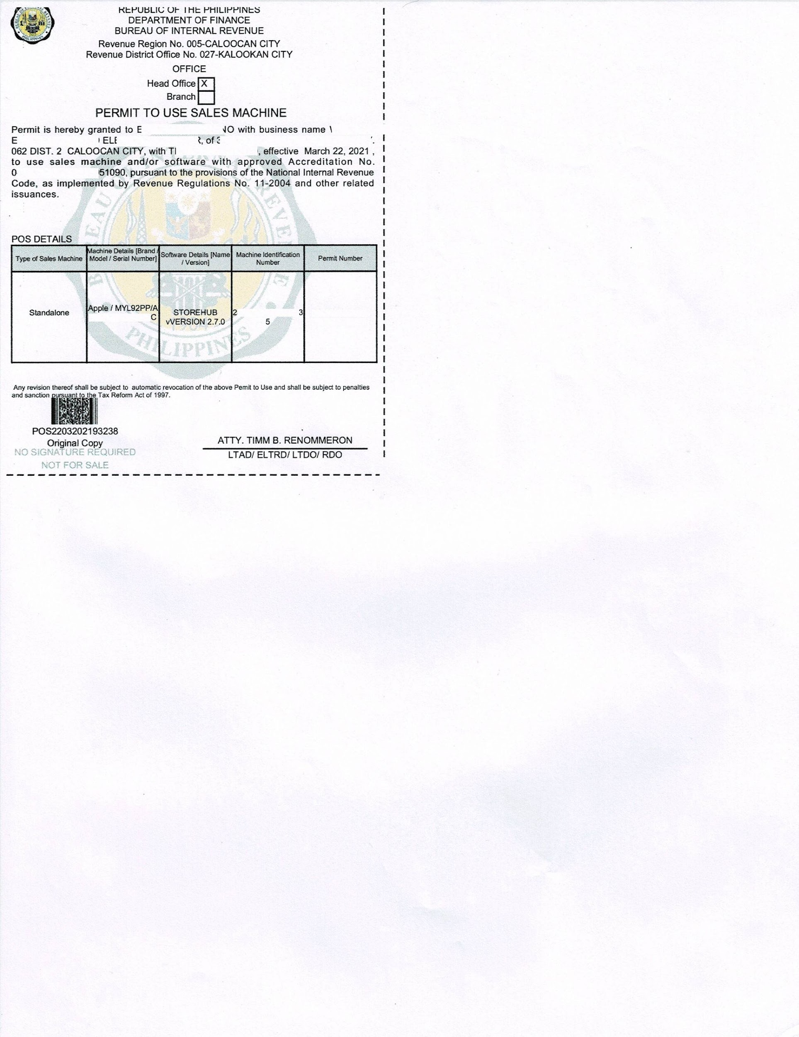
BIR Training
Example of BIR Certificate
Tax Identification Number (TIN)
POS Serial Number
Machine Identification Number
(MIN)
Permit to Use Number
(PTU)
BIR Certificate of Registration
Permit to Use Sales Machine (PTU)
BIR = Bureau of Internal Revenue | TIN = Taxpayer Identification Number | PTU = Permit to Use | MIN = Machine Identification Number

Slide 9
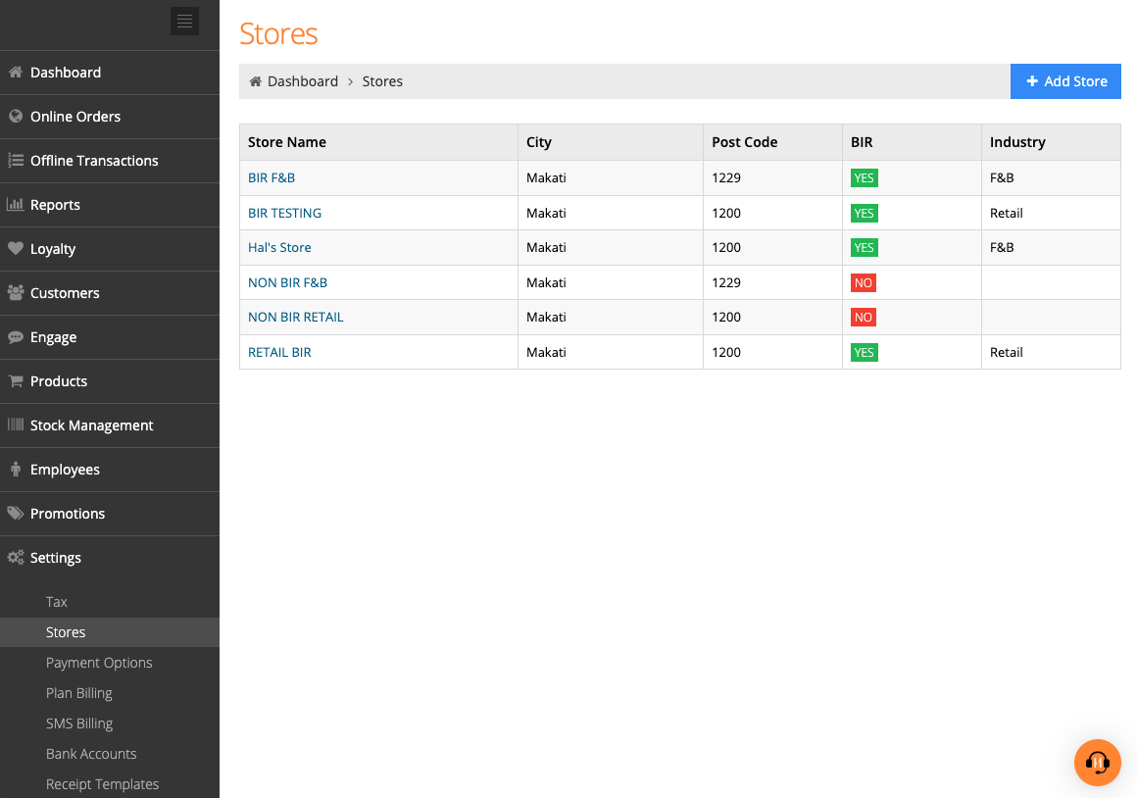
BIR Training
Receipt Information
2
From the BackOffice, go to Settings > Stores
Select the store that have been activated for BIR
1
1
2
BIR = Bureau of Internal Revenue

Slide 10
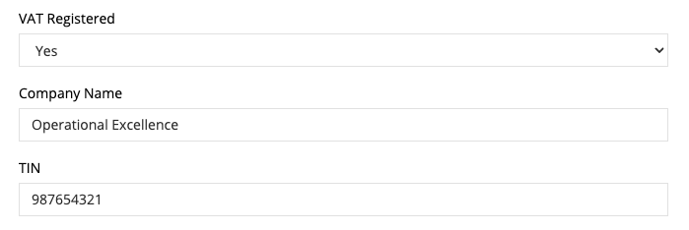
BIR Training
Receipt Information (cont.)
If you are VAT-registered, be sure to select Yes at the VAT Registered field
3
4
5
Tax Identification Number
Specify your VAT Registered
Specify your Company Name
Specify your TIN
3
4
5
BIR = Bureau of Internal Revenue | TIN = Taxpayer Identification Number | VAT = Value Added Tax

Slide 11
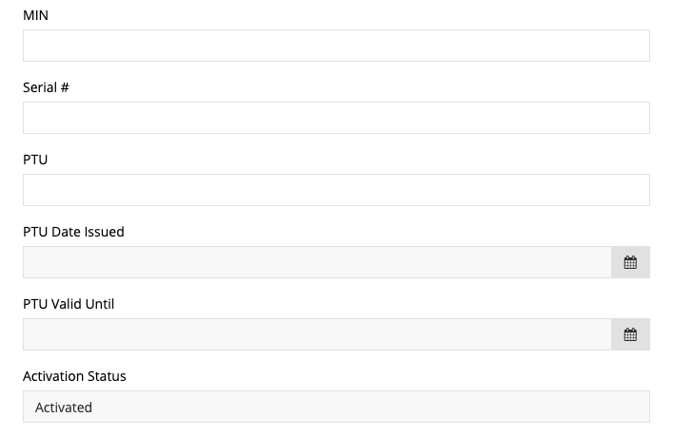
BIR Training
Receipt Information (cont.)
Machine Identification Number
Following numbers will be sent to Merchant by BIR once they are BIR-registered
6
7
Device serial number
(iPad / iMin Serial Number)
8
Permit to Use number
Specify your Company Name
Specify your Serial #
Specify your PTU
6
7
8
BIR = Bureau of Internal Revenue | TIN = Taxpayer Identification Number | PTU = Permit to Use | MIN = Machine Identification Number

Slide 12
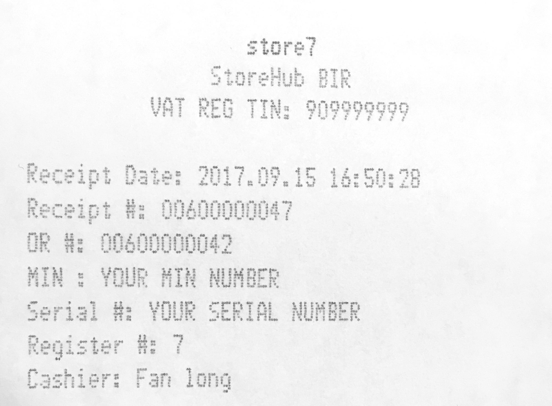
BIR Training
Example: Receipt
MIN Number that merchant provided in BackOffice
Serial Number that merchant provided in BackOffice
BIR = Bureau of Internal Revenue | TIN = Taxpayer Identification Number | PTU = Permit to Use | MIN = Machine Identification Number

Slide 13

BIR Training
X & Z Reading
X Reading
Mid day Report (Overview from beginning of the shift till the time that you have requested)
Z Reading
End of day report (Overview of entire shift)
BIR = Bureau of Internal Revenue

Slide 14

BIR Training
[POS] Generating X & Z Reading Reports

Slide 15
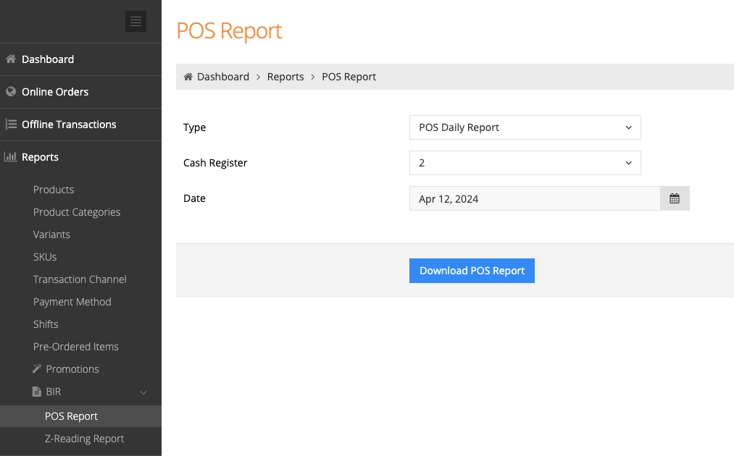
BIR Training
[BackOffice] POS Report
Visit BackOffice > Reports > BIR > POS Report
Select type of report “POS Daily Report / POS Monthly Report”
Download POS Report
2
1
2
3
1
3
The POS Report allows you to select the POS Daily and/or POS Monthly Reports
BIR = Bureau of Internal Revenue | PWD = Person With Disability | SC = Senior Citizen | POS = Point of Sale

Slide 16
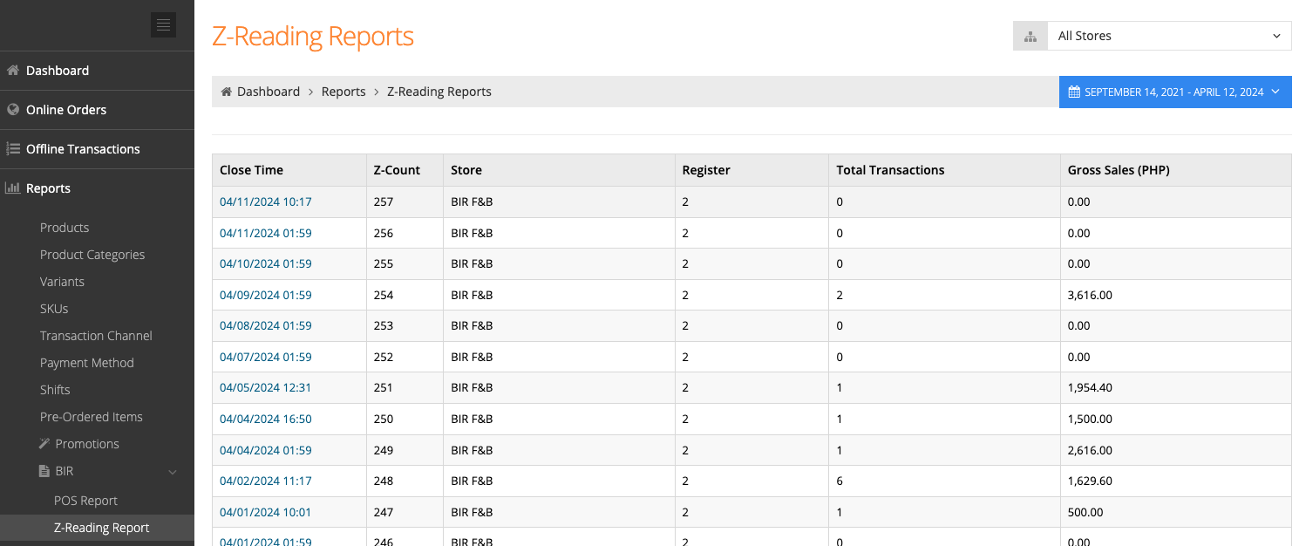
BIR Training
[BackOffice] Z-Reading Report
2
3
1
Visit BackOffice > Reports > BIR > Z-Reading Report
Filter the Date
Select the Closing Time that you required
1
2
3
BIR = Bureau of Internal Revenue | PWD = Person With Disability | SC = Senior Citizen

Slide 17
BIR Training
SC & PWD - F&B
BIR = Bureau of Internal Revenue | PWD = Person With Disability | SC = Senior Citizen

Slide 18
BIR Training
SC & PWD - Retail
BIR = Bureau of Internal Revenue | PWD = Person With Disability | SC = Senior Citizen

Slide 19
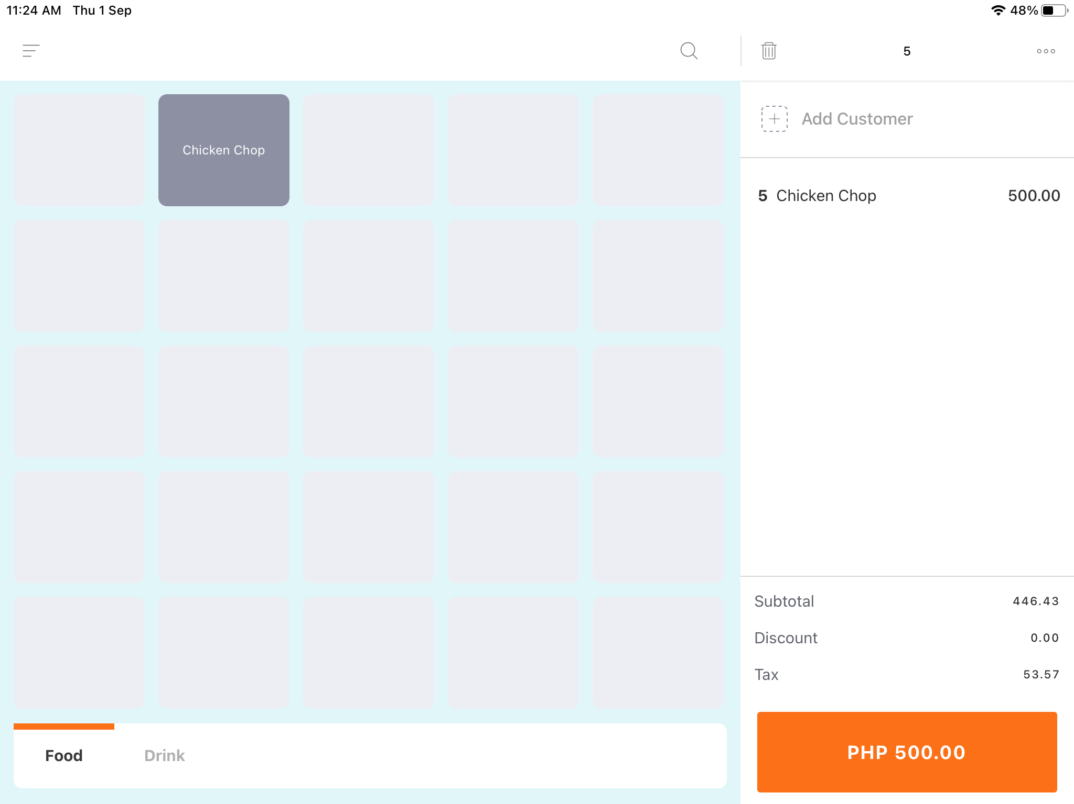
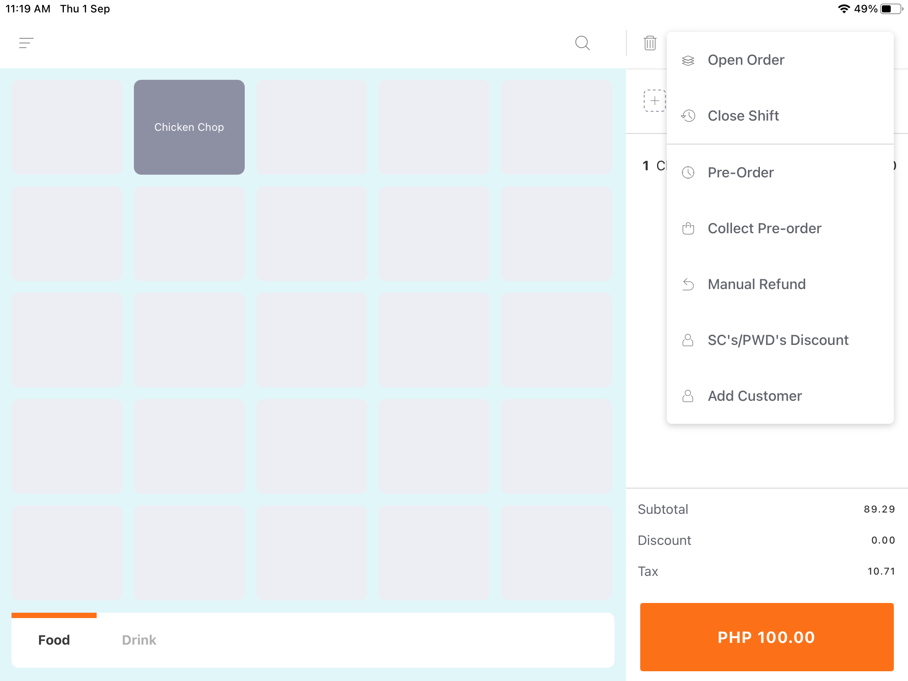
BIR Training
Apply SC/PWD Discount
1
On the iPad Register, tap the menu icon
Select SC’s/PWD’s Discount
1
2
2
BIR = Bureau of Internal Revenue | PWD = Person With Disability | SC = Senior Citizen

Slide 20
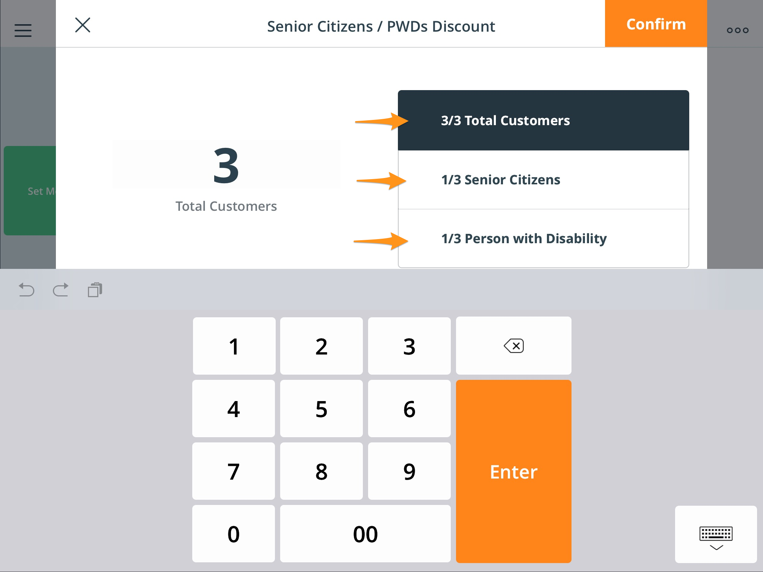
BIR Training
Apply SC/PWD Discount (cont.)
4
3
Enter the total number of customers in the group when the Total Customers button is selected
Key in amount of ‘Senior Citizens’ and ‘Persons with Disabilities’ there are in that group by tapping on the Senior Citizens and Person with Disability buttons
3
4
BIR = Bureau of Internal Revenue | PWD = Person With Disability | SC = Senior Citizen

Slide 21
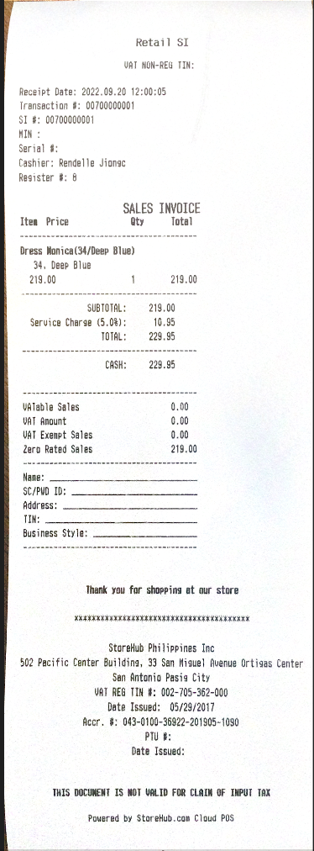
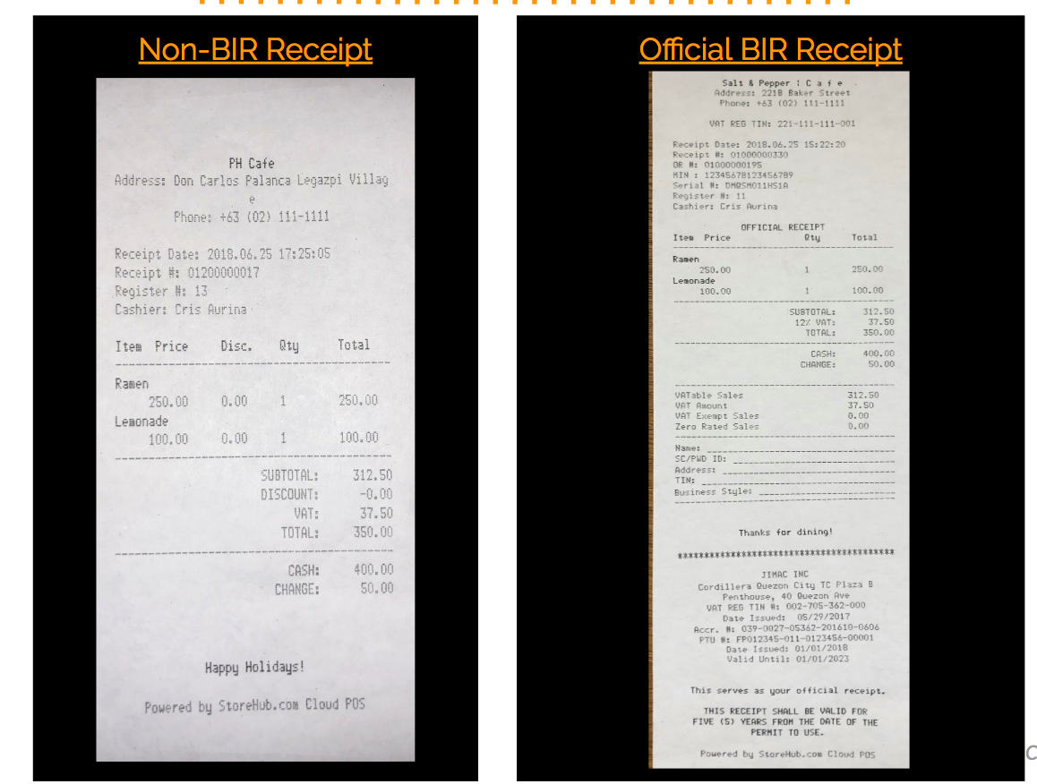

BIR Training
BIR Receipt (Sample)
Sales Invoice
Official Receipt
For Retail Businesses
For F&B Businesses
BIR = Bureau of Internal Revenue | F&B = Food & Beverage

Slide 22
BIR Training
Non-BIR Receipt (Sample)
Non – BIR Receipt
BIR = Bureau of Internal Revenue

Slide 23
BIR Training
FAQ
Questions | Answer
How to set the prices before VAT when BIR is enabled (including Price Books) | As part of BIR compliance, they need to set their Tax code in the BackOffice as 12%
Does Z-reading include cancelled transactions? | Looking at the Z-reading report column in the BackOffice, cancelled transactions are not recorded. It only records refunded transactions
BIR = Bureau of Internal Revenue | FAQ = Frequently Ask Question

Slide 24

CULTIVATE
Check Out More Slides
The End !!!
THIS DOCUMENT IS STRICTLY PRIVATE AND CONFIDENTIAL. THIS IS INTENDED FOR INTERNAL USE ONLY; DO NOT CIRCULATE
Copyright © 2022 Storehub. All rights reserved. No parts of this document can be reproduced, distributed, transmitted or stored electronically without Storehub’s prior written permission.

